Slide 1
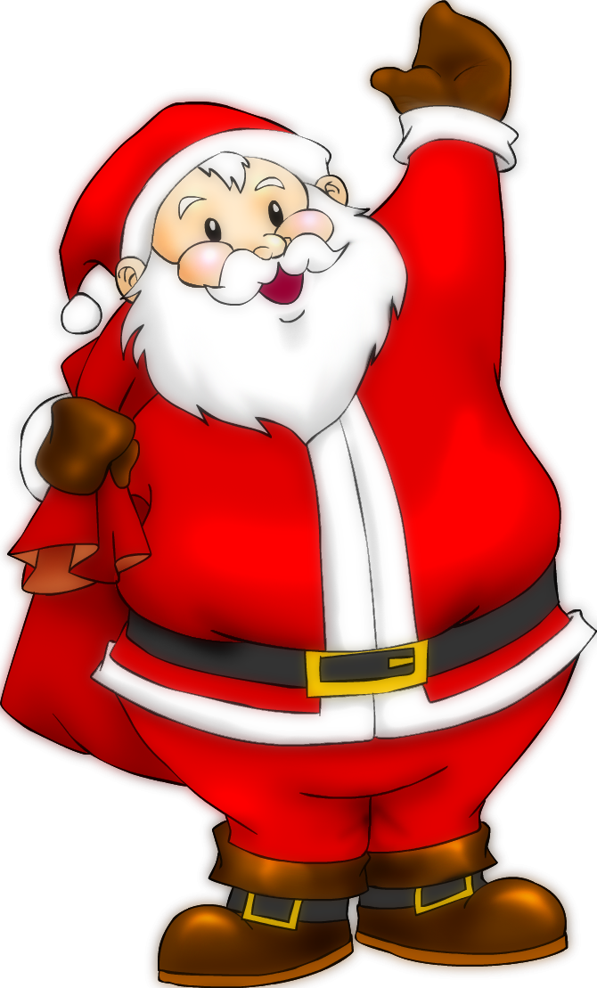
Christmas Quiz
2017

Slide 2
Round 1: Sleigh
A sleigh

Slide 4
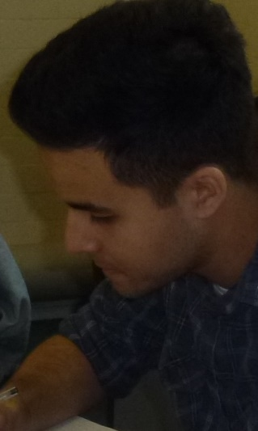
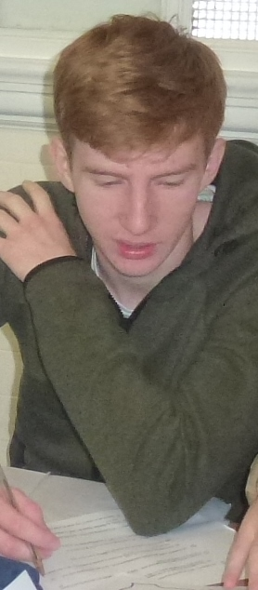
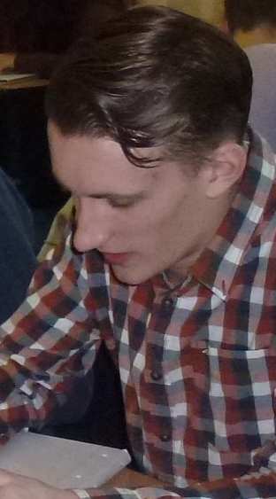
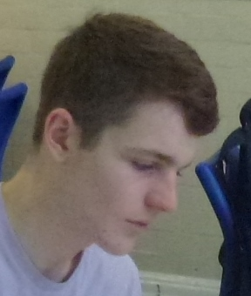
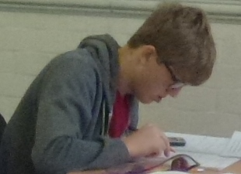
Round 2: Name the student
1 2 3 4 5

Slide 5
Round 2: Name the student
1=Max 2=Dan 3=Yassine 4=Matt 5=Liam

Slide 6
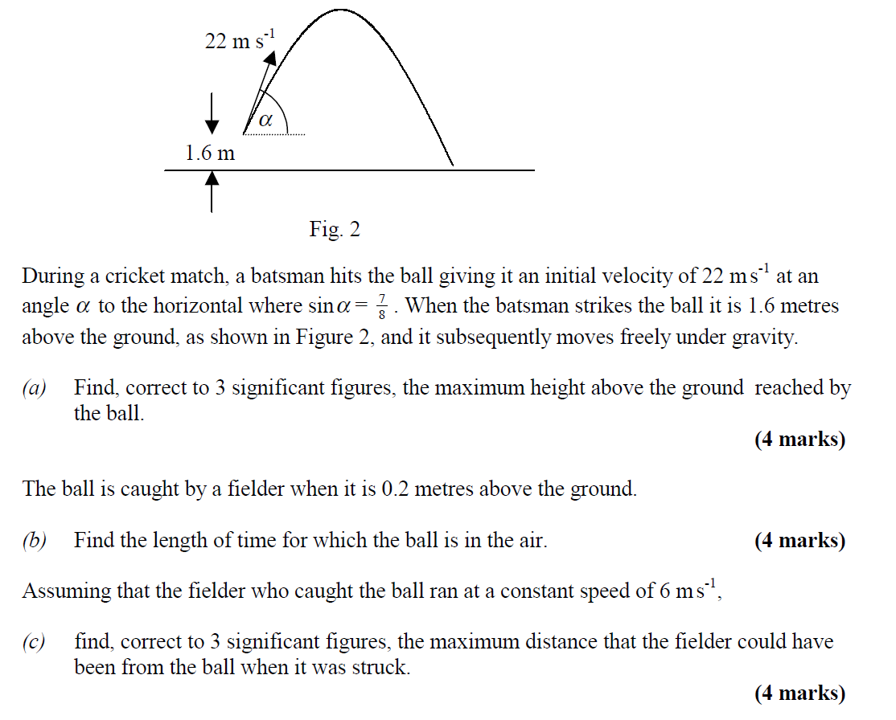
Round 3: Santa’s ball
Santa throws a cricket ball down a chimney giving it an initial velocity of 22 ms⁻¹ at an angle of $α$ to the horizontal where sin $α=\frac{7}{8}$. When Santa throws the ball he is 1.6 metres above ground as shown in the diagram.
a) Find, correct to 3 s.f the maximum height above the ground reached by the ball
The ball is intercepted by a child when it is 0.2 metres above the ground (It’s a slanted chimney, in case you were worrying).
b) Find the length of time that the ball is in the air.
Assuming that the child who caught the ball ran at a constant speed of 6 ms⁻¹ in his excitement on Christmas Day morning,
c) Find, correct to 3 s.f., the maximum distance that the child could have been from the ball when Santa threw it.

Slide 7
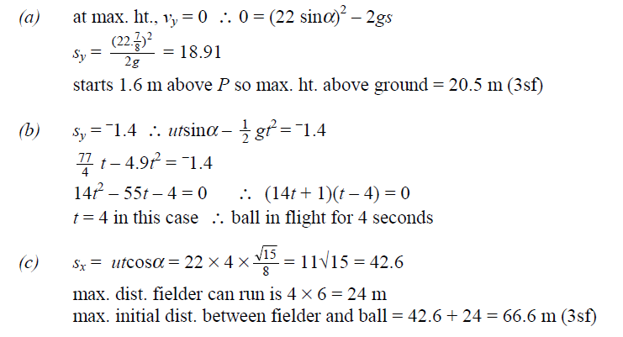

Slide 8
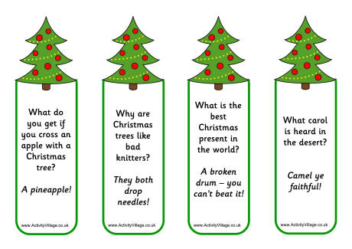
Round 4: Put these jokes in order, funniest first
1
2
4
3

Slide 9
Answers
4 3 2 1

Slide 10
Round 5: Santa’s sleigh
A formula for the height above chimney level of Santa’s sleigh is h= 3 sin 3θ - 4 cos 3θ Find the minimum height of the sleigh and work out the smallest positive value of θ (the angle that Rudolph’s nose makes with the horizontal) at which it occurs.
(for θ, give your answer in degrees to the nearest whole number.)
2) The graph of y = 7 cos θ - 24 sin θ meets the
y-axis at P. State the co-ordinates of P

Slide 11
Trigonometry answers
-5 (2 points)
108° (2 points)
2) (0,7) (2 points)

Slide 12
Round 6: Rudolph’s nose
The number of bacteria in Rudolph’s nose grows according to the following equation
$N = 100 + 50 e^{\frac{t}{30}}$
where N is the number of bacteria present and t is the time in days from midnight on Christmas Eve.
State the number of bacteria present at the start of the experiment
State the number of bacteria present after 10 days
State the day on which the number first reaches 1 000 000
Sketch the graph showing how N varies with t

Slide 13
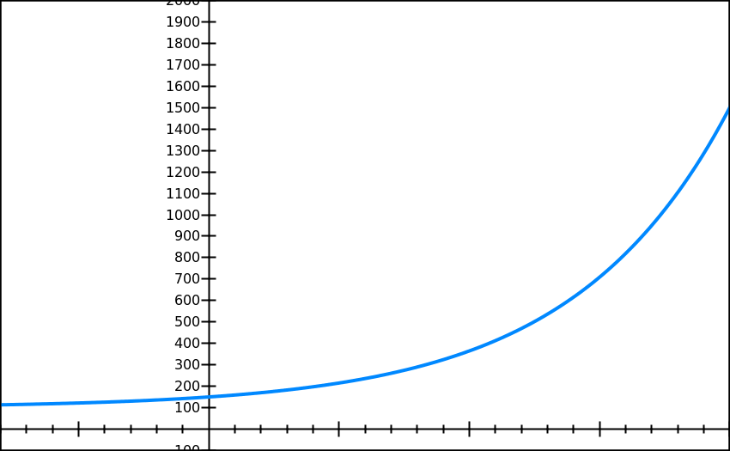
Answers
150
170
298
shape
asymptote (y=100)
cuts y axis at (0,150)

Slide 14
Round 7: Match the Christmas jokes to the punchlines
1) I once bought my kids a set of batteries for Christmas with a note inside saying
2) Why did no one bid for Rudolph and Blitzen on eBay
3) What does Miley Cyrus have at Christmas?
C) Their days are numbered
A) You have three extra hoes
B) He has private elf care
4) Why don’t you ever see Santa in hospital
5) Why is it getting harder to buy Advent calendars
6) How do you know if Santa has been inside your garden shed?
D) Toys not included
F) Twerky
E) They were two deer

Slide 15
Answers
1) I once bought my kids a set of batteries for Christmas with a note inside saying
2) Why did no one bid for Rudolph and Blitzen on eBay
3) What does Miley Cyrus have at Christmas?
F) Twerky
D) Toys not included
E) They were two deer
4) Why don’t you ever see Santa in hospital
5) Why is it getting harder to buy Advent calendars
6) How do you know if Santa has been inside your garden shed?
B) He has private elf care
A) You have three extra hoes
C) Their days are numbered

Slide 16
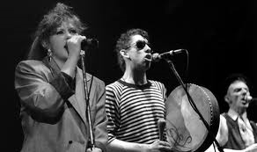
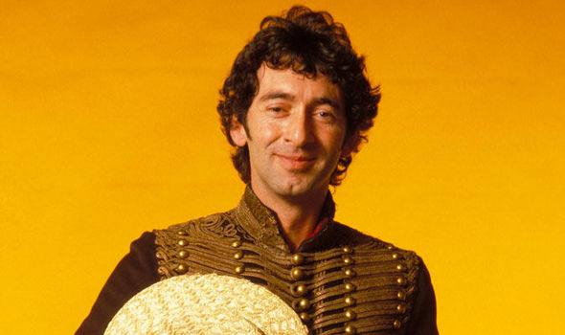
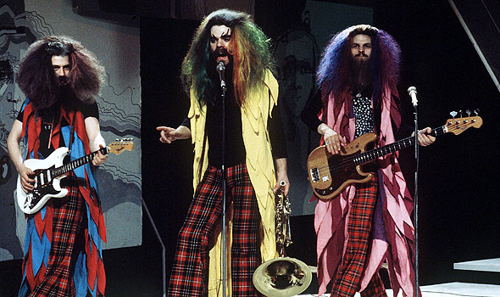
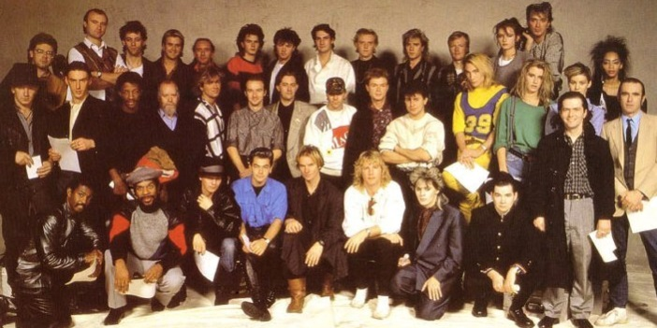
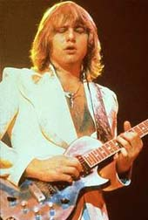
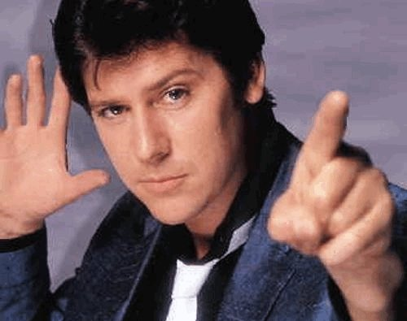
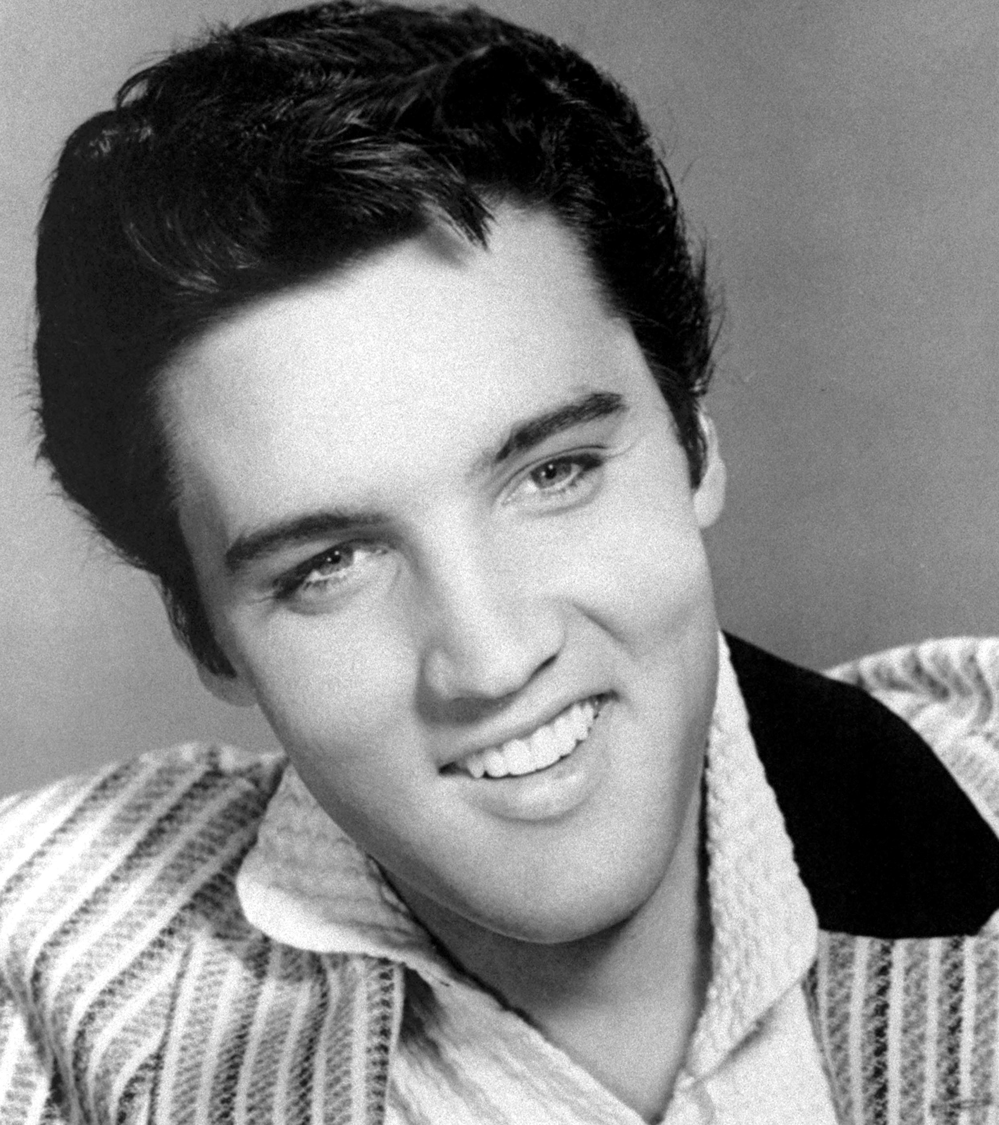
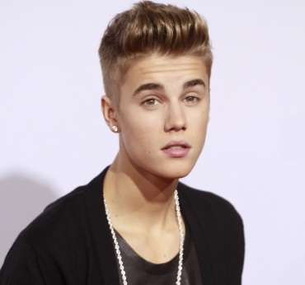
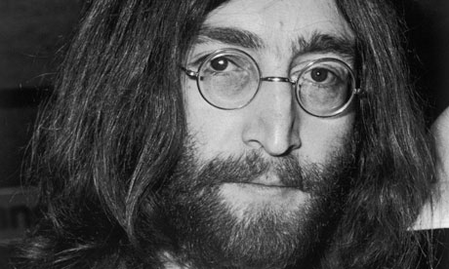
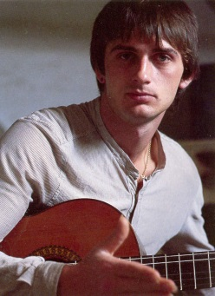
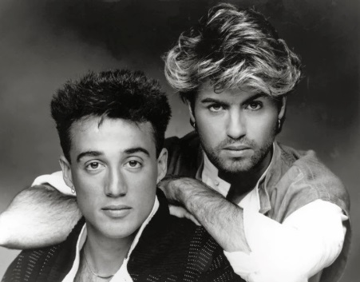
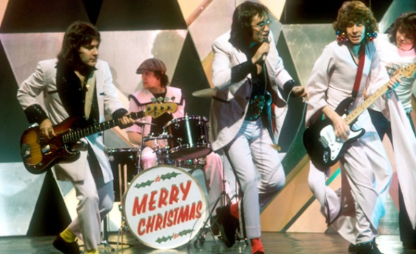
Round 8: Name the artist

Slide 18
Name the artist answers
The Pogues (with Kirsty McColl)
Jona Lewie
Wizzard
Band Aid
Greg Lake
Shakin’ Stevens
Elvis Presley
Justin Bieber
John Lennon
Mike Oldfield
Wham
Mud
Girls Aloud

Slide 19
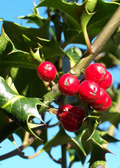
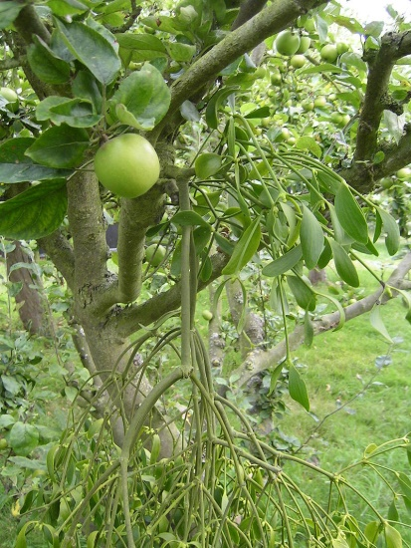
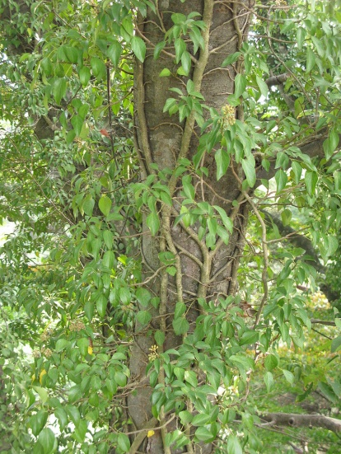
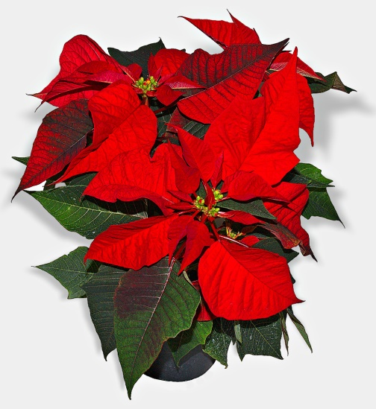
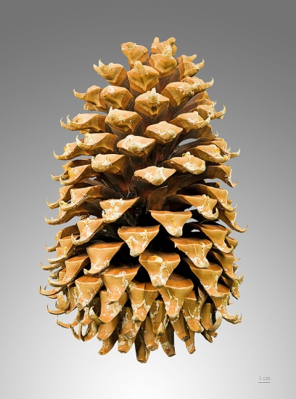
Round 9: Name the Christmas plant
1
2
3
4
5

Slide 20
Name the Christmas plant
1 = Holly
2 = Mistletoe
3 = Ivy
4 = Poinsettia
5 = Pinecones

Slide 21
Round 10: Rudolph The Red Nosed Reindeer
Rudolph the Red-Nosed Reindeer Had a very shiny nose And if you ever saw it, You would even say it -----, And all of the other reindeer Used to laugh and call him names, They never let poor Rudolph Join in any reindeer -----.
Then one ----- Christmas Eve, Santa came to say, Rudolph with your nose so bright, Won't you guide my sleigh tonight
Then how all the reindeer loved him, As they shouted out with ----, Rudolph the red-nose Reindeer You'll go down in -------

Slide 22
Rudolph The Red Nosed Reindeer
Rudolph the Red-Nosed Reindeer Had a very shiny nose And if you ever saw it, You would even say it glows, And all of the other reindeer Used to laugh and call him names, They never let poor Rudolph Join in any reindeer games.
Then one foggy Christmas Eve, Santa came to say, Rudolph with your nose so bright, Won't you guide my sleigh tonight
Then how all the reindeer loved him, As they shouted out with glee, Rudolph the red-nose Reindeer You'll go down in history

Slide 23
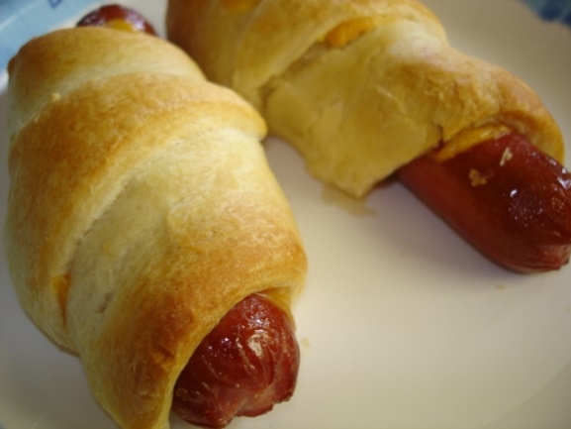
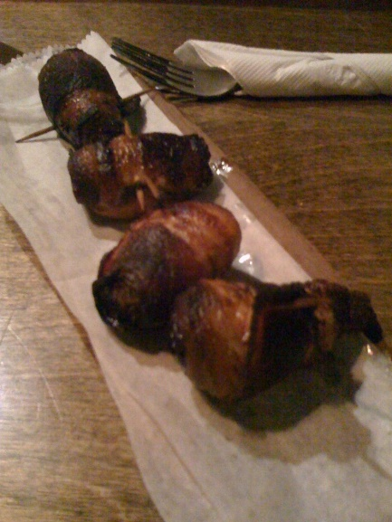
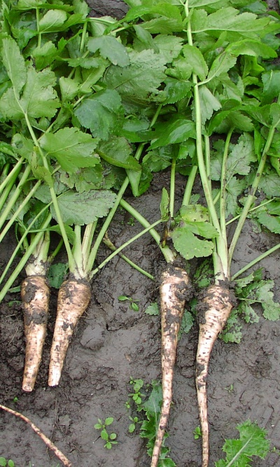
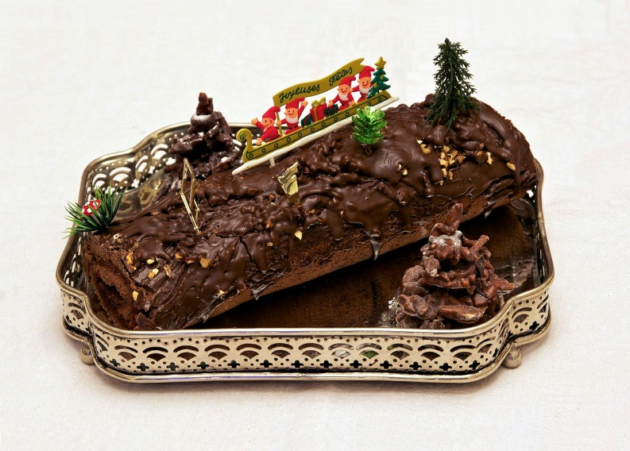
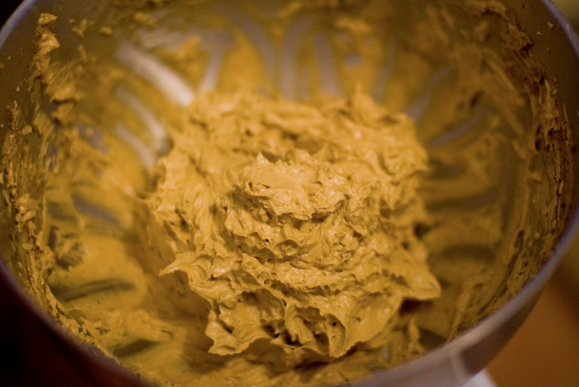
Round 11: Christmas meal – name the item
1
2
3
4
5

Slide 24
Christmas meal – name the item
1=Sausage Roll
2=Pigs In Blanket
3=Parsnips
4=Yule log
5=Brandy Butter

Slide 25
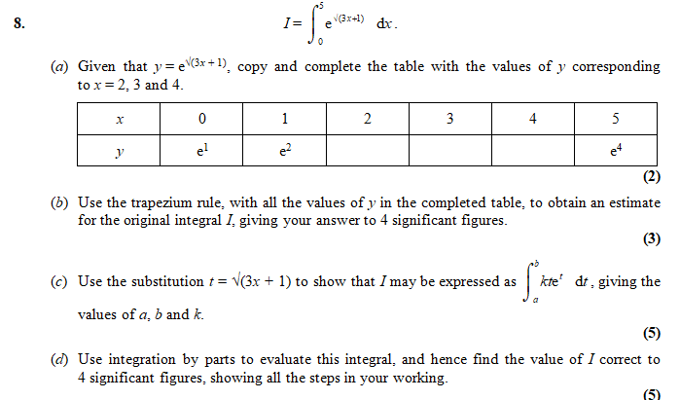
Round 12: A Christmas Trapezium
Give your answers to 5 d.p.

Slide 26
Answers
a) 14.09403, 23.62434, 36.80197
b) 110.6
c) k = $\frac{2}{3}$, a = 1, b = 4
d) 109.2

Slide 27
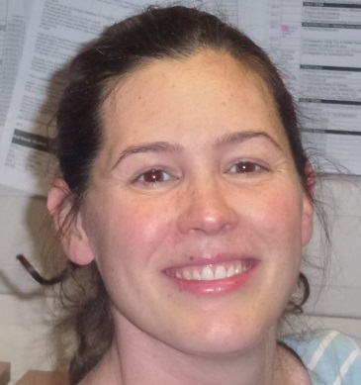
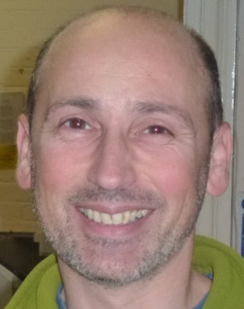
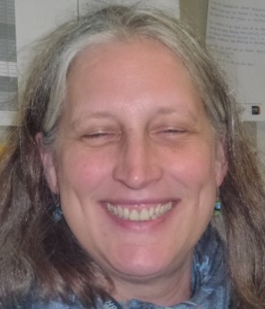
Round 13: Name the Maths teacher
1 2 3 4 5 6
7 8 9 10 11 12
13 14 15 16

Slide 28
Name the Maths teacher
1 Mick 2 Ingrid 3 Mark 4 Ronnie 5 Grace 6 Kim
7 Scott 8 Dea 9 Dave 10 Mark 11 Tarquin 12 Stella
13 Angela 14 James 15 Vivien 16 Gary

