Slide 1
M3

Slide 2
M3 workshop
Every Friday 11:45 – 12:25
Room 5
The Plan is on the website http://www.mickmacve.com/m3.html
The Friday sessions will be used to work through questions

Slide 5
M3
Students are expected to prepare for the lessons by watching the four videos
These videos must be watched before the lessons on
September 29th
October 13th
November 10th
December 8th

Slide 6
M3
Work not completed in the workshops must be completed outside of the lessons
There will be a Mock exam in March or April next year
email support m.macve@bhasvic.ac.uk

Slide 7
M3
There are M3 textbooks in the library which can be taken out on whole year loans. These are very good and will help if you get stuck. You don’t need to bring them to the workshops

Slide 8
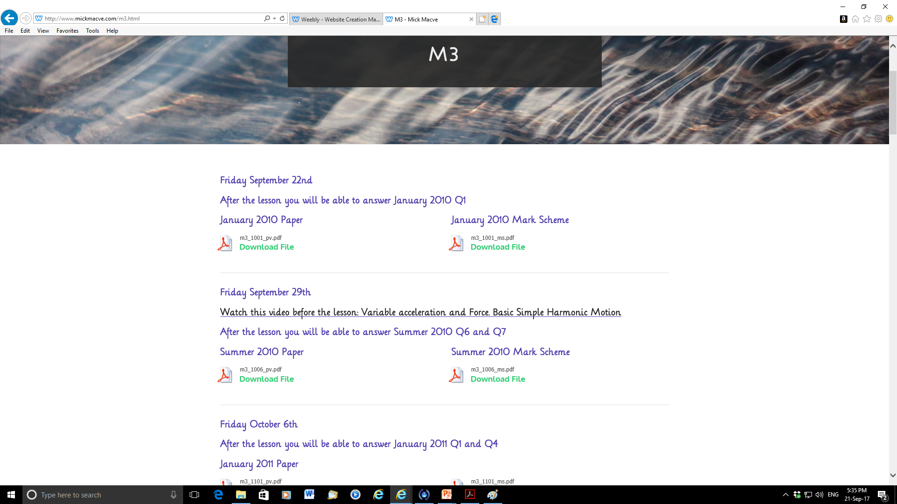
These questions should be completed in the workshop. If not, they must be finished before next week’s workshop

Slide 9
I hope that everyone who starts the course wants to continue with it, attends all the sessions and takes the exam
However, it will be OK to drop out should you wish to do so
But it won’t be OK to attend some sessions and miss others. Regular attendance will be expected.
On the other hand, you can do your own thing if you don’t want to attend on Fridays. I would ask that you keep in touch via email so I know what’s going on

Slide 10
M3
Students will have to pay to enter the M3 module. This is the current situation. Financial worries should be approached in the normal way – have a quiet work with Mick, or your tutor or Student services

Slide 11
M3
I don’t recommend doing this

Slide 19
